Slide 1
ABCD Best Practices
Files and Messages Workshop
June 12-14, 2010
David Boylan, Penn State ARL

Slide 2
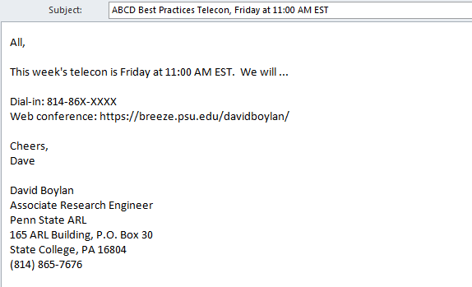
Have you seen this email?
When: Every Friday, pending schedule conflicts
Who: Early adopters of ABCD

Slide 3
Why?
Why meet?
To specify metadata for common use cases that ABCD standard attributes do not address.
Why not just add to ABCD?
Adding additional content to ABCD directly is not feasible.
Why best practices?
“Best Practices” is the most appropriate term for specifications produced by expertise but not authority.
Why bother?
Common metadata supports:
Simpler, faster, and more useful tool creation,
Easier storage and analysis processes,
Shared understanding of data.

Slide 4
Which of these is best?
Metadata describing how often data is collected:
sampling_rate | LVL02.ACQ.TS. sampling_rate | LVL02.ACQ.meas_location. sampling_rate | LVL02.SENS.TS. sampling_rate
SamplingRate | LVL02.ACQ.TS. SamplingRate | LVL02.ACQ.MeasLocation. SamplingRate | LVL02.SENS.TS. SamplingRate
rate | LVL02.ACQ.TS. rate | LVL02.ACQ.meas_location. rate | LVL02.SENS.TS. rate
update_interval | LVL02.ACQ.TS. update_interval | LVL02.ACQ.MeasLocation. update_interval | LVL02.SENS.TS. update_interval
UpdateInterval | LVL02.ACQ.TS. UpdateInterval | LVL02.ACQ.meas_location. UpdateInterval | LVL02.SENS.TS. UpdateInterval
interval | LVL02.ACQ.TS. interval | LVL02.ACQ.meas_location. interval | LVL02.SENS.TS. interval

Slide 5
Metadata Best Practices
Examples and descriptions of all standard ABCD Level 00 and Level 01 metadata
Applies to: Every ABCD file, every time
Does not apply to: People who like their files to be rejected by Gene
Status: Mature draft

Slide 6
Level 02: Time Series
Identifies time element of all data points
Applies to: Any data with timestamps, whether periodic or aperiodic
Does not apply to: histograms, frequency domain
Status: Approved, new version in progress

Slide 7
Level 03: Sequencing
Order multiple files from a single data collection “session”
Applies to: A session of data broken into multiple ABCD files
Does not apply to: ABCD files broken apart by any factor other than time
Status: Pending Approval
ABCD
File
ABCD
Session

Slide 8

Level 04: Multicolumn
Associates multiple zVariables to create structures whole
Applies to: Multi-part data of different data types
Does not apply to: matrices, multidimensional arrays
Status: In progress

Slide 9
Level 05: Classification
“Tag” files with identifiers
Applies to: Files that fall into profiles, such as location or collection effort
Does not apply to: Information already covered by other ABCD metadata
Status: rough draft

Slide 10
Level 06: Asset and Segment
Provide additional asset and segment info in file
Applies to: Helping analysts understand parts breakdown of platform
Does not apply to: Environments with robust MIMOSA databases
Status: rough draft

Slide 11
Level 07: Encoding
Encode data into smaller data types to reduce file size
Applies to: Data that can be translated to scaled integers, fixed point types, or smaller sizes
Does not apply to: Data that should not be reduced
Status: Proposal

Slide 12
Level 08: Histogram
Describe a histogram in ABCD file
Applies to: Histograms
Does not apply to: Things that are not histograms
Status: Draft.

